Slide 1
Credential Assessment & Licensing Guidance

Slide 2
Regulated and Non-Regulated Professions in Canada
Regulated Occupations
Public Health and Safety Concerns
Credential Assessment (WES/IQAS/Licensing Body)
Non-regulated Occupations
Credential Assessment (WES/IQAS)
Work in related Field
Licensing Process through Regulatory Body
Work in related Occupation

Slide 3
Non-regulated Professions In Canada
A job in a non-regulated occupation is one for which you don’t need a license, certificate or registration to work. Most jobs in Canada are in non-regulated occupations.
For Example: Biologist, Economist, Receptionist

Slide 4
Regulated Professions in Canada
Many professions set their own standards of practice. These are called regulated occupations.
In Canada, about 20 percent of jobs are in occupations regulated by the provincial or territorial governments.
Through legislation and regulations, the provinces and territories give to professions the authority to self-regulate in order to protect public health and safety, and to ensure that professionals meet the required standards of practice and competence.
If you want to work in a regulated occupation and use a regulated title, you must have a licence or a certificate or be registered with the regulatory body for your occupation in the province or territory where you plan to work.
Some fields where regulated occupations are commonly found include:
* Education
* Health care
* Financial services
* Law and Legal services
* Engineering

Slide 5
Examples of Regulated Professions in Canada
Accountant
Architect
Dentist
Doctor
Engineer
Lawyer
Nurse
Pharmacist
Social Worker
Teacher- SPTRB
Early Childhood Educators- Ministry of Education

Slide 6
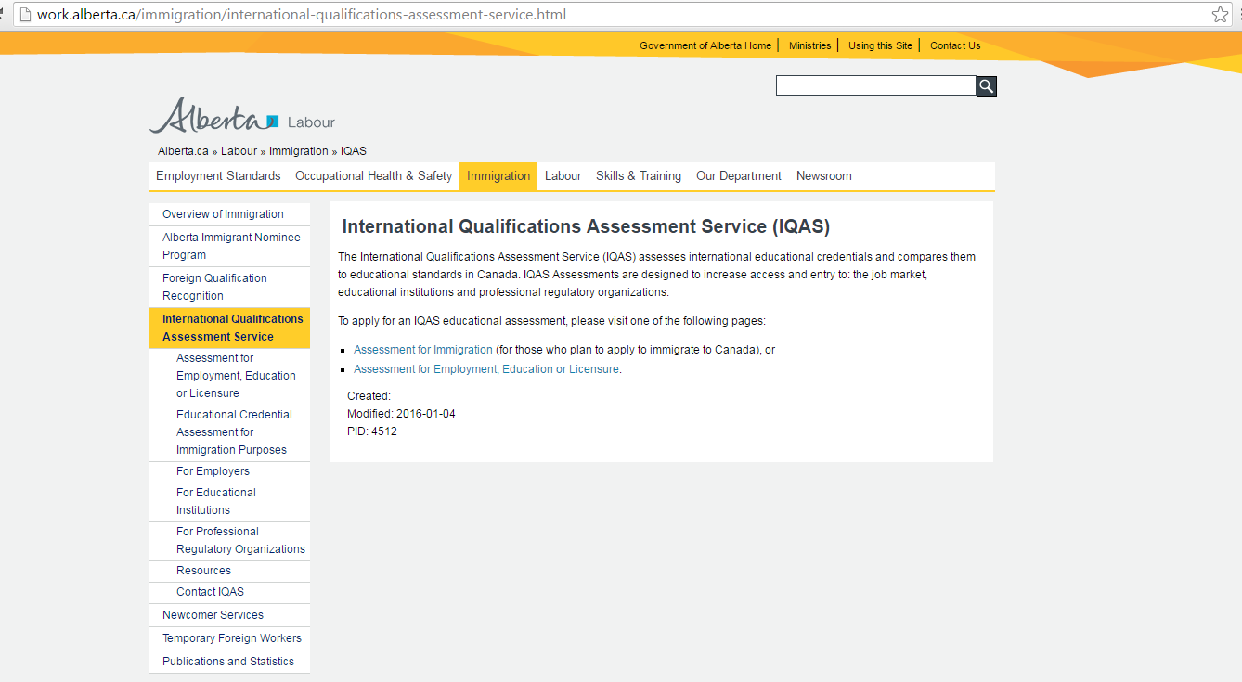
IQAS/WES – for Unregulated Occupation

Slide 7
Step By Step WES Application Process
Click Apply Now

Slide 8
Check Step 1 and Step 2
Click the Standard Online Application- For use in Canada

Slide 9
Create an Account
Enter your First and Last name as it appears in your Passport or PR
Create an Account

Slide 10
ONLINE APPLCIATION TIPS
Always remember your account information
The user name and the password
Write it down in a place where you can easily access
http://www.wes.org/ca/

Slide 11
Regulatory Bodies in Saskatchewan
Teacher Licensing- Saskatchewan Professional Teachers Regulatory Board (SPTRB)
Engineer Licensing - Association of Professional Engineers and Geoscientists of Saskatchewan (APEGS)
Accounting Body- CPA Saskatchewan
Early Childhood Educators- Ministry of Education SK
Nursing License- Saskatchewan Association Of Licensed Practical Nurses (SALPN)
https://www.saskatchewan.ca/residents/moving-to-saskatchewan/immigrating-to-saskatchewan/working-in-saskatchewan/regulated-occupations-and-licensing-requirements/saskatchewan-regulatory-bodies

Slide 12
International Educated & Licensed RN
National Nursing Assessment Service (NNAS)-advisory report
Saskatchewan Registered Nurse Association
The NNAS application process will produce an Advisory Report that includes an evaluation of your education according to approved Canadian standards and compares your education to current Canadian nursing requirements.
It contains the following:
1. An evaluation of your education, according to Canadian nursing entrance to practice requirements and standards.
2. Background information about your schools and dates you attended.
3. Verifications of your license/registration and credential sources.
4. Your employment history.
5. Evidence of English language proficiency.
Regulatory Body - Saskatchewan Registered Nurse Association
https://www.srna.org/licence_membership/becoming-a-nurse-in-sask/registered-nurse-sask/internationally-educated/

Slide 13
Practical Nursing-SALPN
PROGRAMS:
https://salpn.com/internationally-educated-nurses-2/
https://saskpolytech.ca/programs-and-courses/programs/Practical-Nursing.aspx
Three mandatory competencies are required for licensure by legislation in Saskatchewan:
Health Assessment
Medication Administration
IV Initiation/Therapy
Applicants who did not graduate with the above classes included in their nursing education course or who haven’t taken the courses outside of their nursing education will be required to enroll through Saskatchewan Polytechnic and provide proof of completion within their application for SALPN licensure.
Visit Saskatchewan Polytechnic for enrollment dates.

